Slide 1
Preferential Attachment Model Time Evolution
MA 653: Network Science
Instructor: Ashok Singh Sairam
ashok@iitg.ac.in

Slide 2
Time evolution of the network
Do older nodes have higher degree, as they have more time to acquire links?
Yes
Does it twice old means twice the number of edges?
Greater than that
Oldest nodes in the network end up receiving the lion’s share of the edges.
This behaviour is known as the first mover effect.

Slide 3
Time evolution of the network
Consider again the general preferential attachment model
The time of creation is measured in terms of the number of vertices, the first vertex having t = 1 and the last having t = n. Alternatively, you can just think of t as counting the vertices from 1 to n, recording the order in which they were added. Strictly t need not reflect actual time, because the vertices need not have been added at a constant rate, but if we know the real times at which vertices were added we can easily convert between our timescale and real time.
p_{q}(t,n) is the probability that a node created in time t, will have in-degree q when the network has n nodes in total
Time is discrete and increases every time a new node is created
t=1 corresponds to the creation of the first node and so on
In general, it is easier to use instead of the above probability its density
We rescale the time using:
Then we have π_{q}(τ,n) being the density, that is, π_{q}(τ,n)dτ is the probability that vertices created in the interval [τ, τ+dτ] have in-degree q

Slide 4

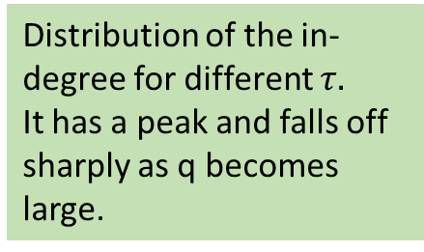

First mover effect
Using again the master equation method we can obtain a differential equation for the density function
Eventually we get:
q=1
$$τ=0.9$$
Nodes of given degree are
concentrated around an era.
As degree increases era
gets earlier
Distribution of the in-degree for different $τ.$
It has a peak and falls off sharply as q becomes large.
q=2
q=5
$τ=0.$01
q=10

Slide 5
First mover effect
As we can see nodes of a specific degree are concentrated around a particular era in the growth of the graph
The higher the degree the earlier this era is
If we focus now on nodes that were created around the same era in the growth of the graph, we see that their degree distribution differs
Older nodes exhibit flat degree distribution, while as we move to younger nodes we see an exponential decay
There is no power law if we focus on nodes that were created around the same time
However, when we integrate over all times τ we see the power law

Slide 6
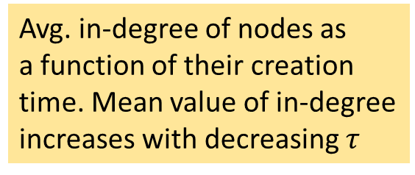
Effect of time of creation on the in-degree
The average in-degree of a vertex created at time τ is:
Diverges for τ=0. However, note that the smallest value for τ is 1/n
Avg. in-degree of nodes as
a function of their creation
time. Mean value of in-degree
increases with decreasing $τ$

Slide 7
Effect of time of creation on the in-degree
If we return to the absolute time notion, and t is the time at which the vertex was created and s is the elapsed time:
The expected in-degree of the vertex added at time t, as a function of its age s is:
For small s<<t → linear growth of the in-degree
Constant of proportionality is smaller for younger vertices
For large s>>t →growth is smaller than linear but still favors vertices that appeared earlier

Slide 8
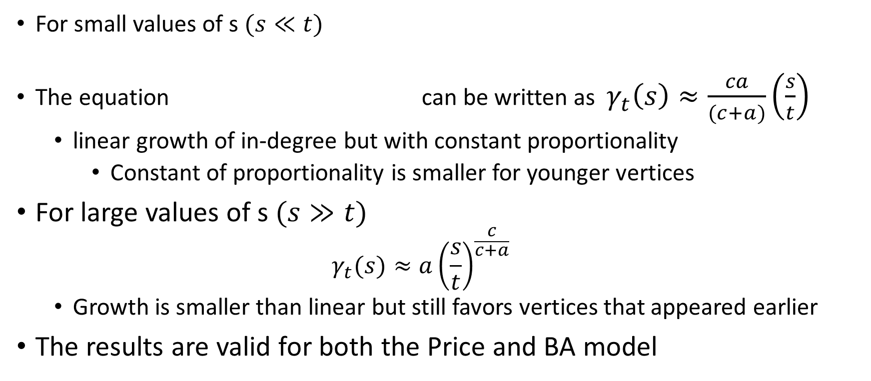
Effect of time of creation on the in-degree
For small values of s $(s≪t)$
The equation can be written as $γ_{t}\left(s\right)≈\frac{ca}{(c+a)}\left(\frac{s}{t}\right)$
linear growth of in-degree but with constant proportionality
Constant of proportionality is smaller for younger vertices
For large values of s $(s≫t)$
$$γ_{t}(s)≈a{\left(\frac{s}{t}\right)}^{\frac{c}{c+a}}$$
Growth is smaller than linear but still favors vertices that appeared earlier
The results are valid for both the Price and BA model

Slide 9
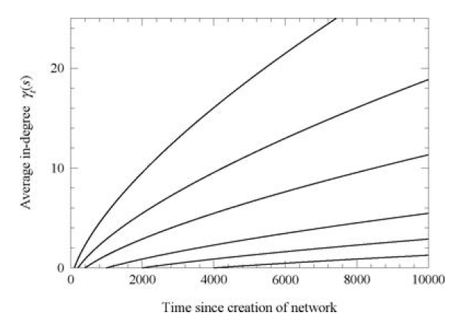
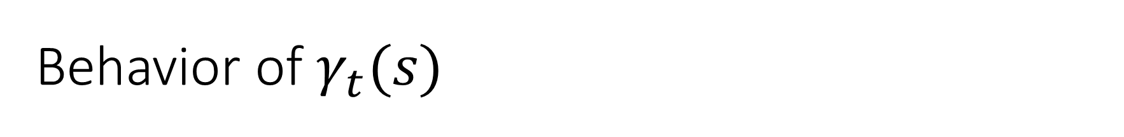
Behavior of $γ_{t}(s)$
Average in-degree of Price’s model of nodes created ad different times
c=3 and a=1.5
t=100
t=200
t=400
t=1000
t=2000
t=4000

Slide 10
Extensions of preferential attachment
Price and BA models include many oversimplified assumptions for the way networks grow
In particular, they assume that nodes and edges are only created (never deleted) and a vertex can initiate new edges only at the time of creation
While these assumptions might hold with good approximation for citation networks they do not hold true for other types of networks
In Web links are not permanent and can be created at any time
Entire webpages can also disappear (vertex removal)
Why the preferential attachment should be linear in the degree?

Slide 11
Addition of extra edges
While in citation networks no new edges can be created by a vertex after the time of the node generation this is not true for the majority of the networks
For example, the WWW is constantly changing
A network evolution model that can deal with the creation of new edges is the following:
At each step, the new node creates exactly c new edges which attach to other vertices with probability proportional to degree k [same as before]
In addition, at each step some number w of extra edges are added to the network with both ends attaching to vertices chosen in proportional to degree
Thus, when the network has n vertices it will have n(c+w) edges

Slide 12
Addition of extra edges
Every new node brings c+2w ends of edges
2 extra for each of the w extra edges
The normalization factor for the attaching probabilities is the sum of the degree of all nodes
This is equal to twice the number of edges, that is, 2n(c+w)
The probability that a node with degree k will attract one of the new edges is:
p_{k}(n) is the fraction of nodes with degree k when the network has n vertices

Slide 13

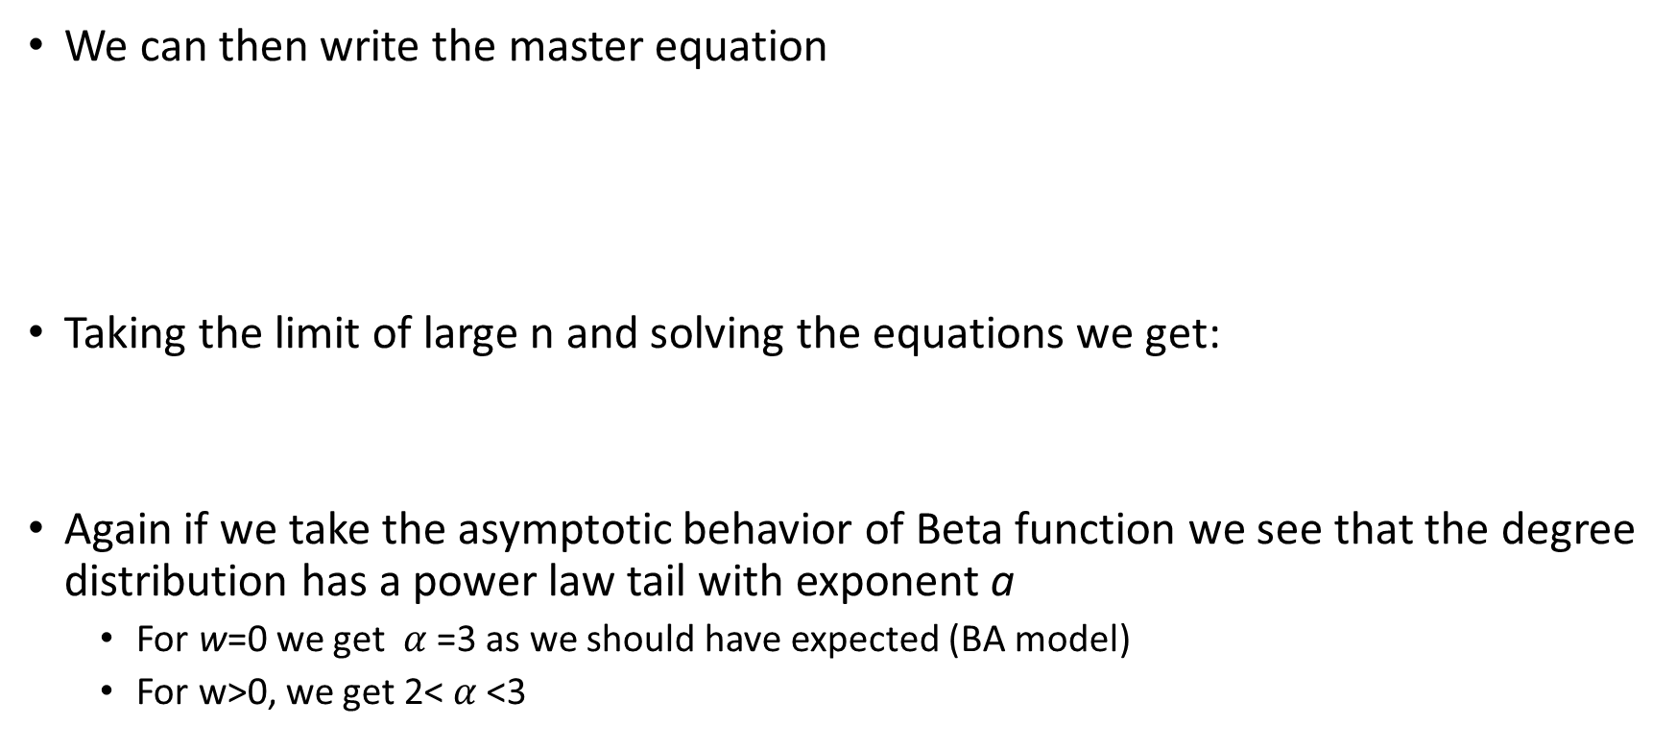
Addition of extra edges
We can then write the master equation
Taking the limit of large n and solving the equations we get:
Again if we take the asymptotic behavior of Beta function we see that the degree distribution has a power law tail with exponent a
For w=0 we get $α$=3 as we should have expected (BA model)
For w>0, we get 2< $α$<3
$$p_{k}=\frac{B(k,α)}{B(c,α−1)} where α=2+\frac{c}{c+2w}$$

